Slide 1
Lean Six Sigma Black Belt Project
Project Name: Ship Performance Clustering-BB Project
Process: Shipping Operations Optimization
Prepared By: K.S.Manjunath

Slide 2
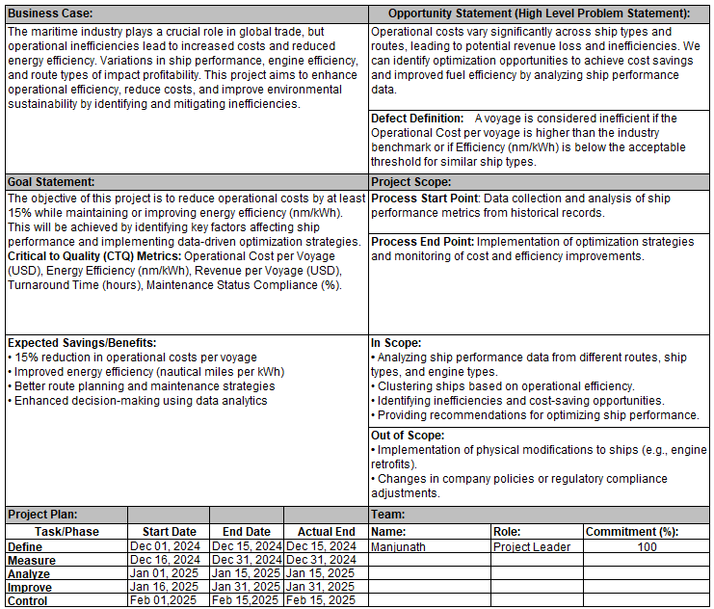
Project Charter

Slide 3
Define Phase

Slide 4
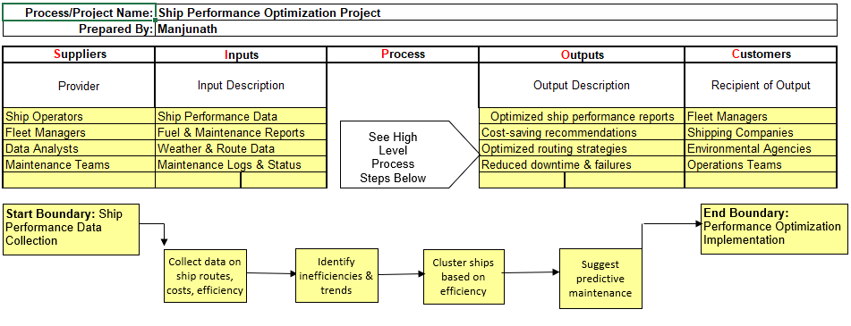
SIPOC Diagram

Slide 5
Voice of Customer
Who | What did they say
Fleet Managers | Need real-time ship performance data to optimize routes, improve efficiency, and reduce costs.
Shipping Companies | Looking for cost-saving recommendations and increased profitability.
Maintenance Teams | Require predictive maintenance insights to prevent unexpected failures.
Regulatory Bodies | Need improved compliance with fuel efficiency and emission regulations.

Slide 6

Key VOC Insights:
High operational costs impact business profitability.
Inefficient fuel consumption increases environmental impact and expenses.
Unplanned maintenance leads to downtime and delays.
Shipping route selection plays a crucial role in efficiency and cost reduction.
Integration of VOC in Project Goals:
After capturing the Voice of Customer (VOC), it was essential to integrate these insights into clear project goals to ensure that our solutions directly address customer needs. This section bridges the gap between VOC feedback and actionable project objectives
Align process optimization with cost-reduction goals.
Enhance predictive maintenance strategies based on operational data.
Improve compliance with industry fuel efficiency standards.

Slide 7

Measure Phase

Slide 9
Data Collection Plan
Purpose of Data Collection
Establish a baseline for ship performance metrics.
Ensure accurate insights for process improvement and optimization strategies.
Data Source | Data Type | Frequency | Responsible Party
Ship Logs | Operational Data | Per Voyage | Fleet Managers
Engine Reports | Fuel Consumption | Weekly | Maintenance Teams
Financial Records | Cost & Revenue | Monthly | Finance Department
Weather Reports | Route Conditions | Daily | Data Analysts

Slide 10
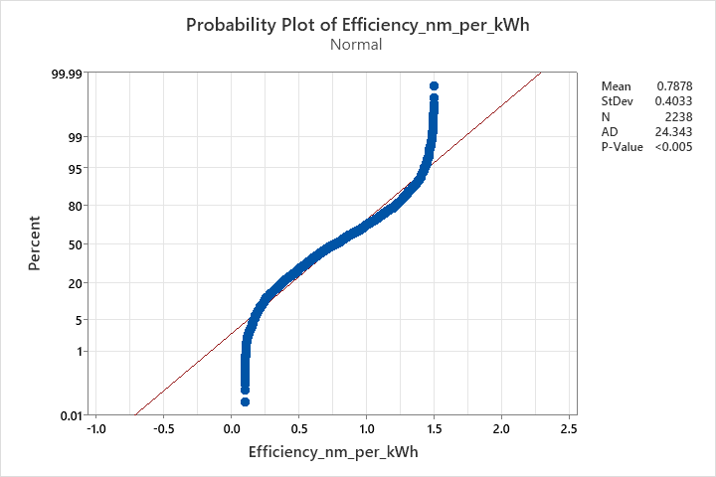
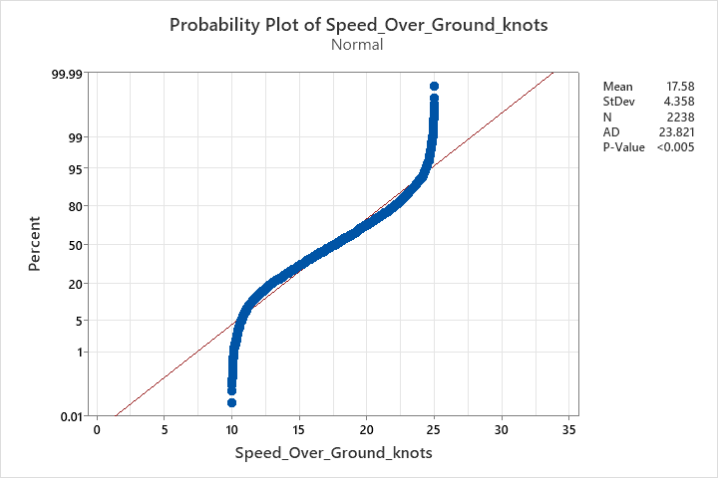
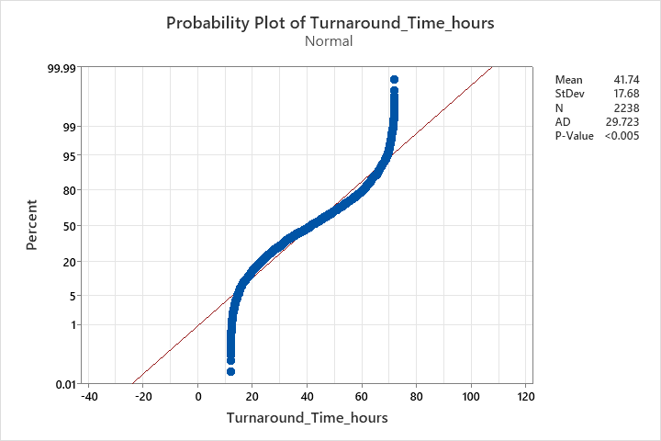
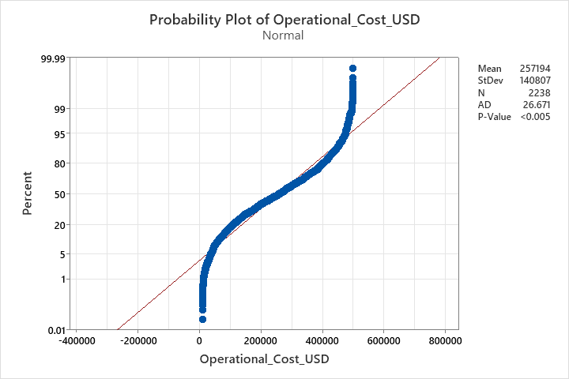
Understanding process variation – Normality Test
Key Learnings from Probability Plots:
Most variables fail the normality test (p-value < 0.005), requiring a non-normal capability analysis. However, Turnaround Time (After Improvement) follows normality, indicating process stabilization.

Slide 11
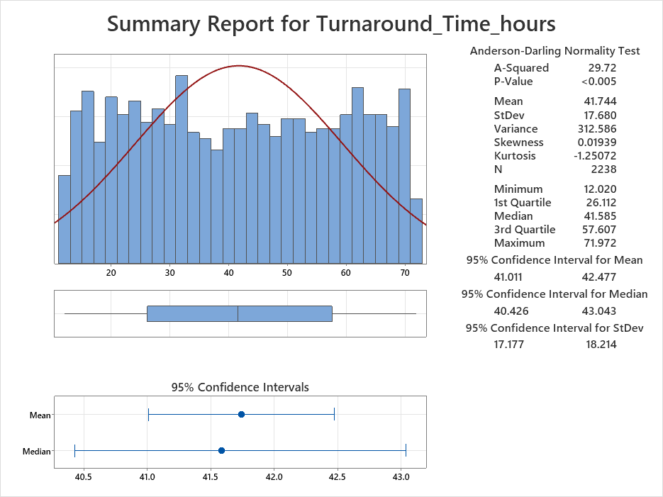
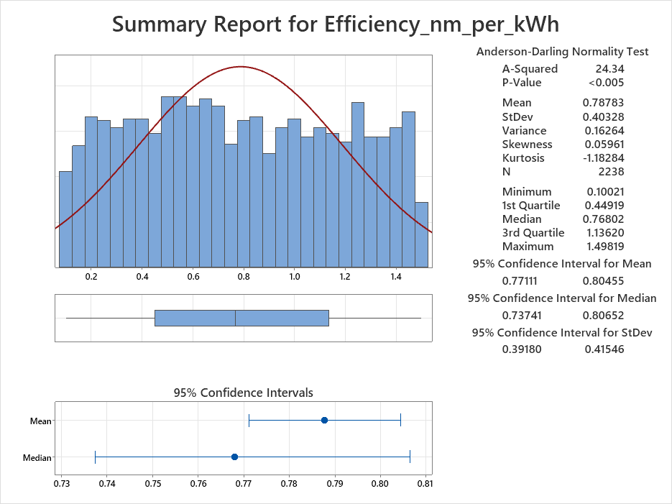
Understanding process variation
Key Learnings from Summary Reports:
All variables fail the normality test (p-value < 0.005),requiring non-normal capability analysis.
Efficiency (nm/kWh) has moderate variation with a mean of 0.7878 and a wide confidence interval, indicating process inconsistency.
Turnaround Time (hours) is highly variable (StDev = 17.68), suggesting operational inefficiencies that need further analysis.

Slide 12
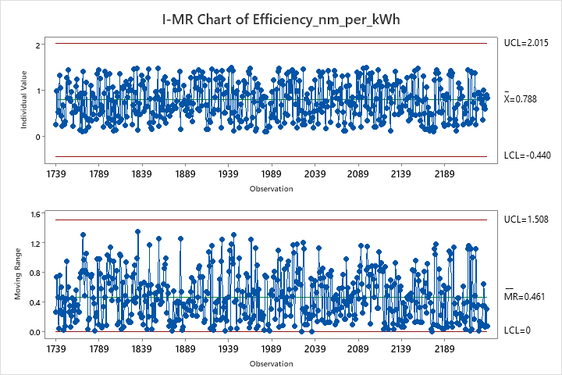
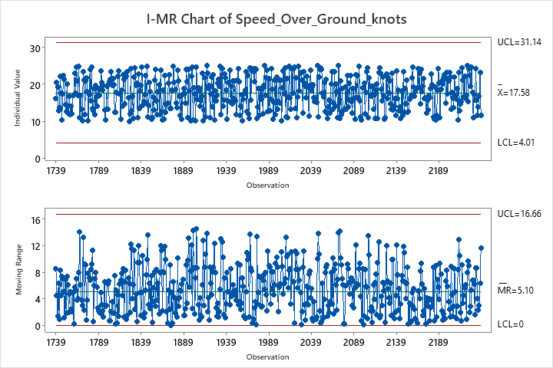
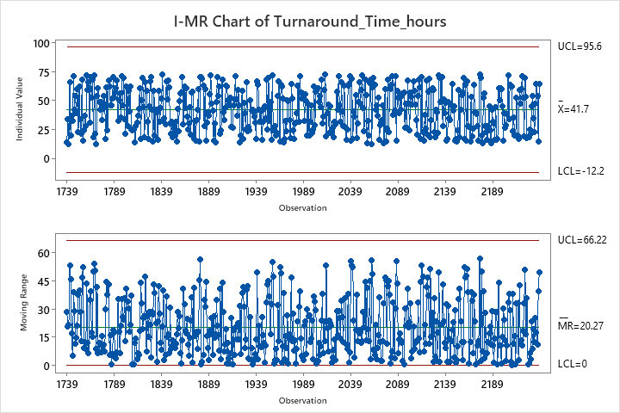
Understanding Process Variation
Key Learnings from I-MR Charts:
All processes appear stable, with no major out-of-control points, but high variability exists in Turnaround Time and Speed.
Efficiency (nm/kWh) fluctuates between 0.44 and 2.015, indicating potential process inefficiencies.
Turnaround Time (hours) shows wide variation (UCL = 95.6, LCL = 12.2), requiring deeper analysis to reduce inconsistencies.

Slide 13
Output Sigma: Understanding the Capability of the Process
Define the Following:
CTQ: Turnaround Time (TAT) in hours
Target: TAT should be less than 60 hours
Defect: Any turnaround time greater than or equal to 60 hours
Unit: Hours
Opportunity: Each turnaround time observation
S.NO | ATTRIBUTES | SYMBOLS | VALUE
1 | Number of Observations (Units Produced) | N | 2238
2 | Total Number of Defects (TAT > 60 hours) | D | 467
3 | Number of Defect Opportunities per Unit | O | 1
4 | Defects per Million Opportunities (DPMO) | DPMO | 208668.45
5 | Sigma Level | SIGMA | 2.0
DPMO=(D/N*O​)×1,000,000

Slide 14

Key Insights:
With a Sigma Level of 2.0, significant improvements are needed to achieve a Six Sigma level (>4). Implementing process control strategies will help reduce variation and improve efficiency
A high DPMO (208,668.45) suggests that many turnaround times exceed the target of 60 hours.
Next Steps: Implement Lean & Six Sigma strategies to reduce variation and improve process efficiency.

Slide 15
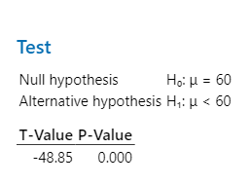
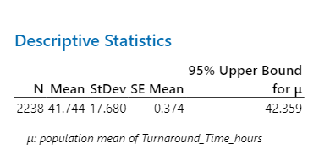
Hypothesis Test: Evaluating Turnaround Time Performance
Key Learnings:
The paired t-test confirms that the average turnaround time (TAT) has significantly decreased from the previous level and is now well below the 60-hour target, indicating process improvement.

Slide 16
Analyze Phase

Slide 17
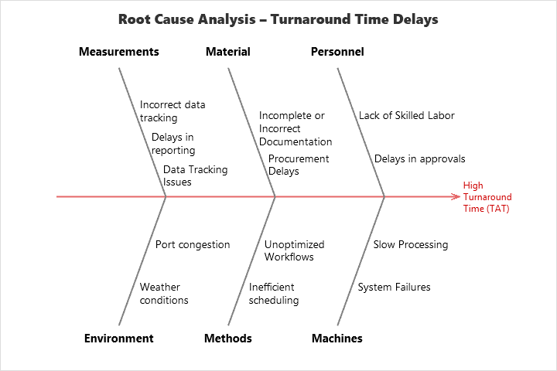
Cause and Effect Diagram
The cause-and-effect (fishbone) diagram helps to analyze why Turnaround Time (TAT) is high by categorizing possible causes. It visually highlights problem areas, making it easier to identify and fix root causes rather than just symptoms.

Slide 18
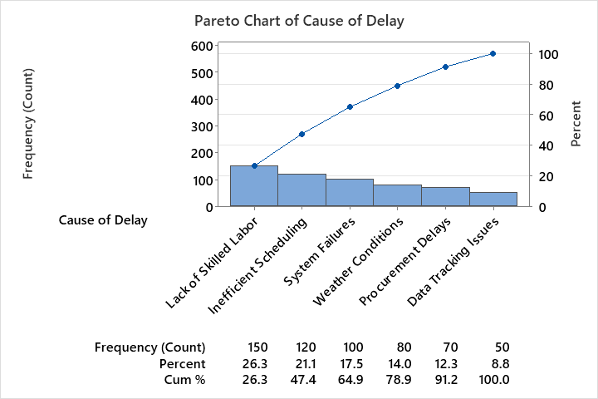
Pareto Chart - Cause of Delay
Interpretation of the Pareto Chart for Cause of Delay
1. Major Contributors to Delays (80/20 Rule)
Lack of Skilled Labor (26.3%) and Inefficient Scheduling (21.1%) are the two biggest contributors, together accounting for 47.4% of all delays.
System Failures (17.5%) and Weather Conditions (14.0%) further contribute, bringing the total to 78.9%.
2. Key Insights
Focus first on addressing "Lack of Skilled Labor" and "Inefficient Scheduling" as they contribute the most to delays.
Target process improvements on training, workforce optimization, and better scheduling methodologies.
System failures and weather conditions also play a role but are secondary priorities.

Slide 19
Prioritization of X’s: Control / Impact Matrix using Fishbone Diagram
Control \ Impact | High Impact | Medium Impact | Low Impact
In Our Control | - Requirements Clarity & Delivery Delays | - Vendor Selection Delay | - Equipment Not Available
 | - Delivery Delay | - Approval Delay | - Lack of Clarity
 |  |  | - No KPIs, Software Issues
 |  |  | - Skills, SOP Not Followed, Training
Out of Our Control | - Weather Delays | - Defects in RM | - High Temperature

Slide 20
Narrow to Root Causes – Display Your Data
1. Purpose of the Analysis
Why were Scatter Plots and Box Plots created?
To identify key factors influencing Turnaround Time (TAT).
To validate the root causes affecting efficiency, operational cost, and voyage revenue.
To analyze trends and variations across different ship types.
2. Variables Analyzed
What relationships are being analyzed?
Scatter Plots show relationships between key variables, such as:
Efficiency vs Turnaround Time
Operational Cost vs Distance Traveled
Revenue per Voyage vs Distance Traveled
Box Plots show variability in turnaround time, cost, and efficiency across ship types.
3. Ship Types Considered
Brief description of the ship types analyzed:
Bulk Carrier: Large ships used for carrying unpackaged bulk cargo (e.g., coal, grain).
Container Ship: Ships that transport standardized cargo containers.
Fish Carrier: Specialized vessels designed for transporting seafood.
Tanker: Ships used for transporting liquid cargo (e.g., oil, chemicals).

Slide 21
4. Expected Outcome
What insights are expected from these analyses?
Identify which ship type has the highest turnaround time.
Determine whether efficiency, operational cost, or voyage revenue significantly impact TAT.
Highlight which ship type requires process improvements.

Slide 22
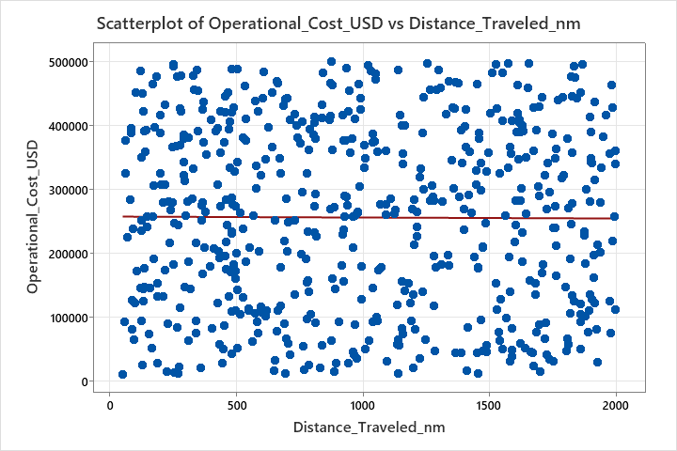
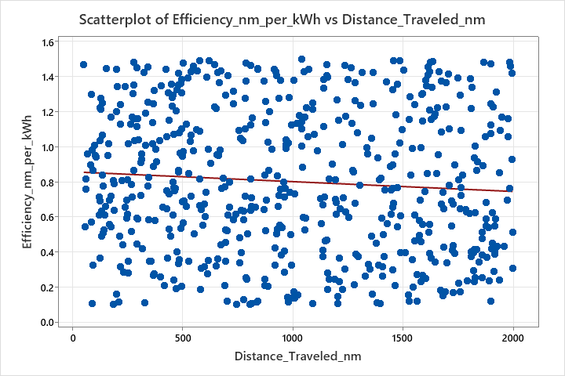
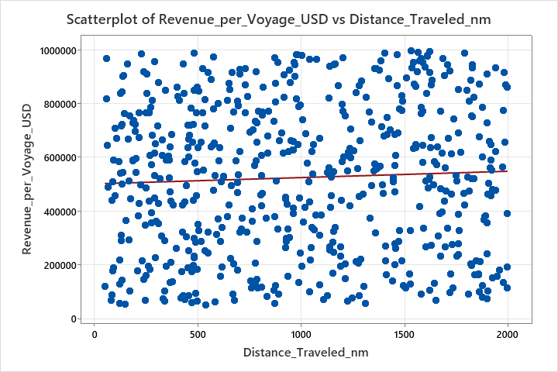
Scatter Plots – Relationship Analysis (Grouped by Ship Type)
Bulk Carrier
No significant correlation; cost remains variable with distance indicating other factors (like fuel price fluctuations or maintenance costs) influence cost more than distance.
Weak inverse relationship; efficiency slightly decreases as distance increases, possibly due to fuel consumption inefficiencies over long trips.
Weak positive correlation; longer voyages tend to generate slightly higher revenue, but the impact is small.
We analyzed ship types separately to understand how distance traveled impacts operational cost, efficiency, and revenue for each category

Slide 23
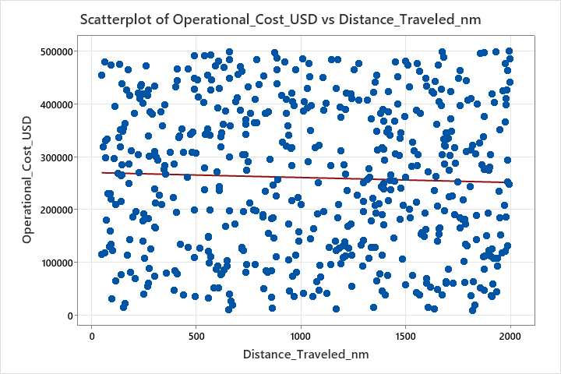
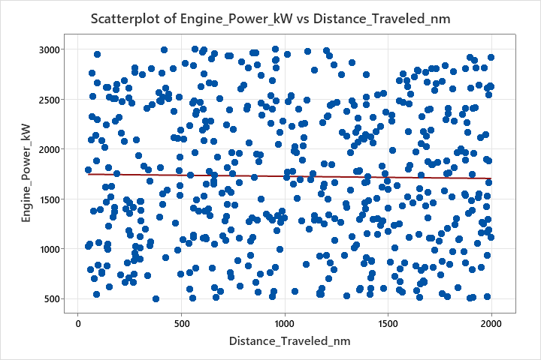
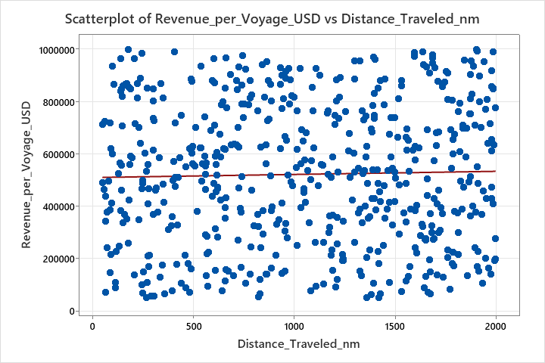
Container Ship
Weak negative correlation; cost slightly decreases with distance.
No significant relationship; power remains stable across distances.
Weak positive trend; revenue slightly increases with distance.

Slide 24
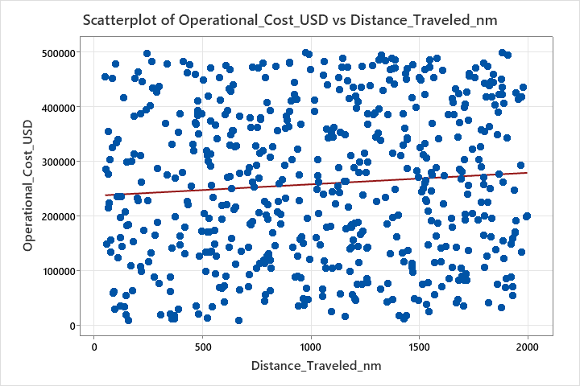
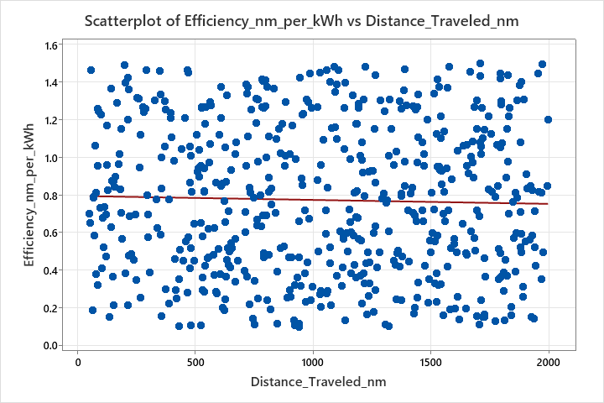
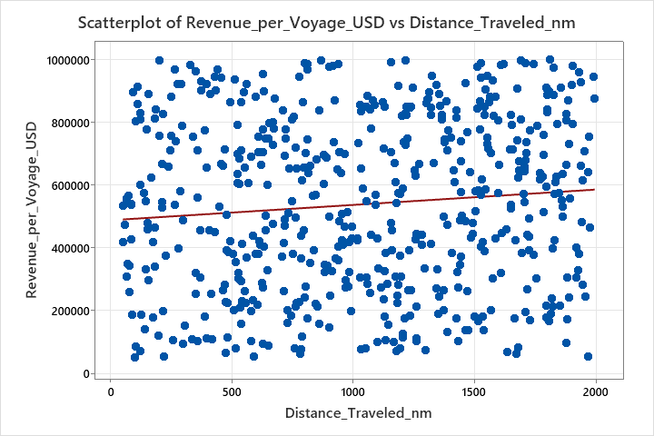
Fish Carrier
Weak positive correlation; cost slightly increases with distance.
No significant relationship; efficiency remains stable across distances.
Weak positive trend; revenue slightly increases with distance.

Slide 25
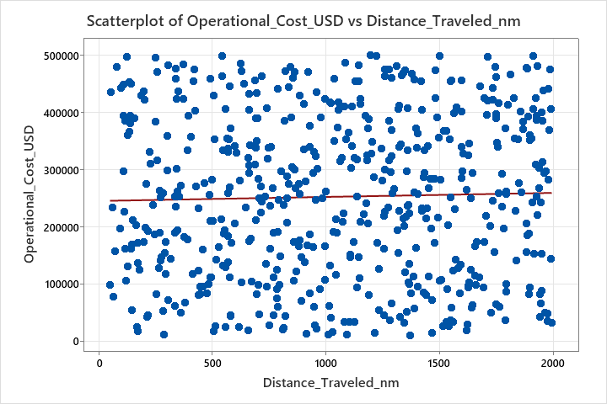
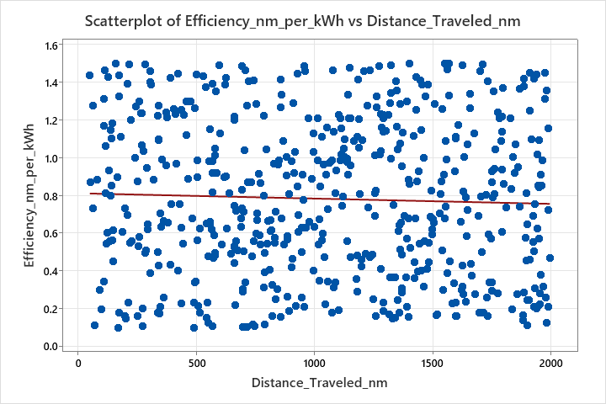
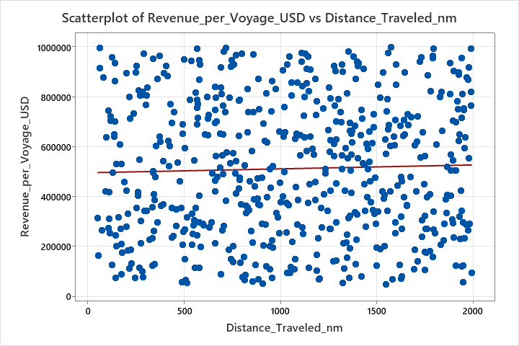
Tanker
Slight positive correlation; cost marginally increases with distance.
No significant relationship; efficiency remains largely unchanged.
Weak positive trend; revenue increases slightly with distance.

Slide 26
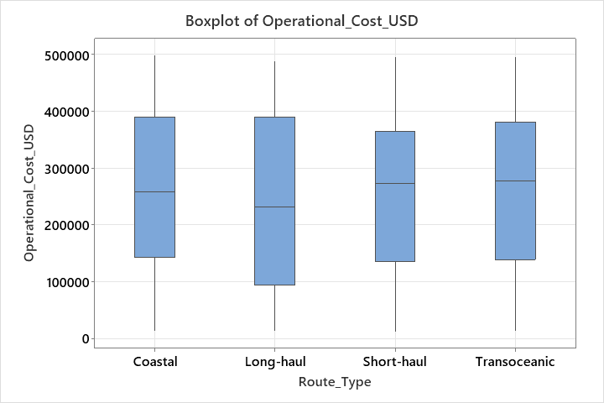
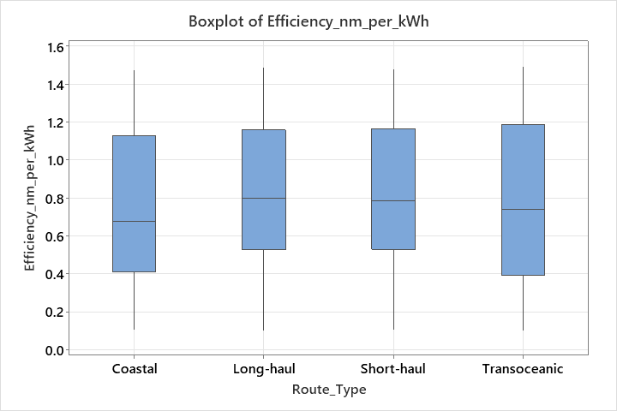
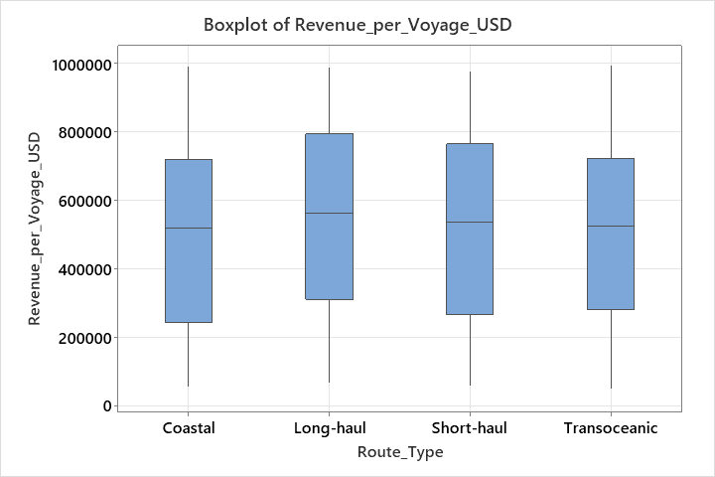
Box Plots – Distribution Comparison (Grouped by Ship Type)
Bulk Carrier
Costs are relatively consistent across routes, with slight variations in median values.
No extreme outliers, suggesting cost is not highly impacted by route type.
Insight: Cost optimization strategies should focus on other factors like fuel pricing or maintenance schedules rather than route type.
Revenue distribution is similar across routes, with minor variations in spread.
No major shift in median revenue between short-haul, long-haul, or transoceanic routes.
Insight: Route selection does not significantly impact revenue for bulk carriers—optimizing operational costs might be a better focus.
Efficiency remains stable across all route types, showing no significant difference.
The spread of efficiency values is similar, meaning route type does not affect ship fuel efficiency significantly
Insight: Since efficiency does not vary much, other factors like cargo load or ship condition might play a bigger role

Slide 27
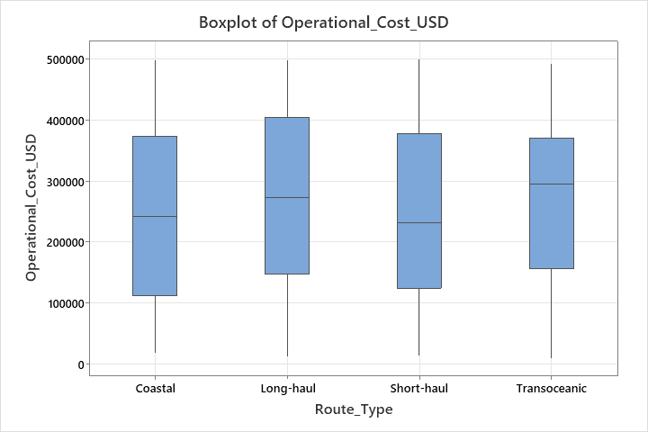
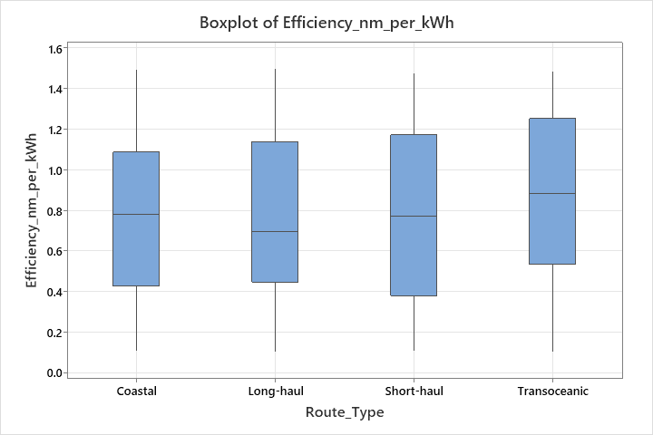
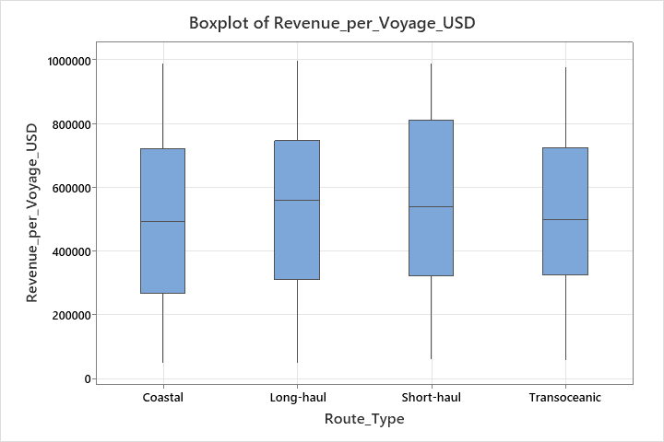
Container Ship
Costs are relatively similar across route types, but Long-haul routes show slightly higher median values compared to others
Transoceanic routes exhibit slightly better efficiency, while other routes remain consistent.
Revenue distribution is nearly uniform, but Long-haul routes have a marginally higher median revenue.
Key Insights:
Long-haul routes show higher costs and revenue, while Transoceanic routes tend to be more efficient.
Further analysis is required to optimize costs while maintaining efficiency and revenue balance

Slide 28
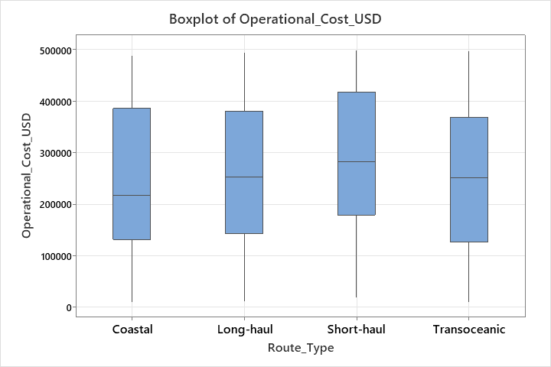
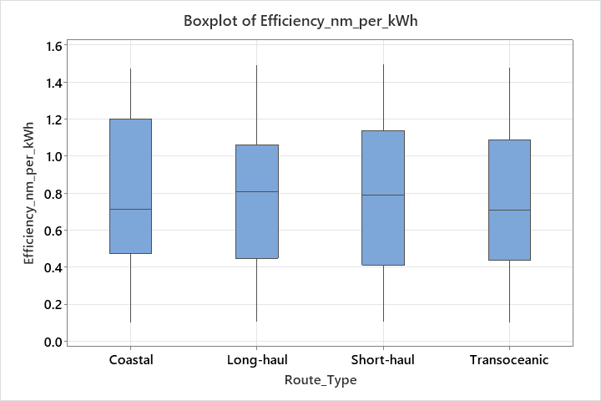
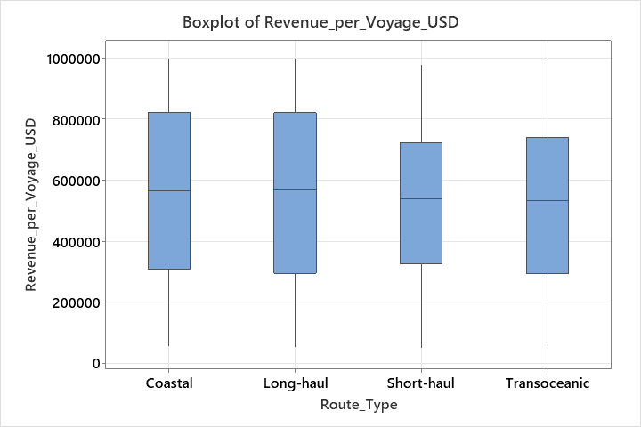
Fish Carrier
Cost variation is high across all route types, but median costs remain consistent.
Efficiency shows slight variation among routes, with long-haul routes having slightly lower medians.
Revenue remains comparable across route types, with coastal and long-haul routes showing higher medians.
Key Insights:
There is no significant variation in operational cost, efficiency, or revenue across route types. This suggests that factors beyond route type (e.g., ship type, operational decisions) may be influencing these metrics.

Slide 29
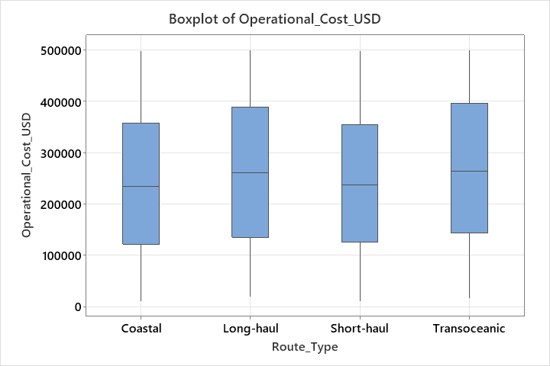
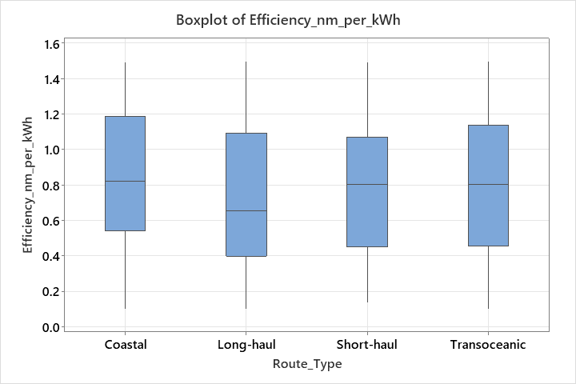
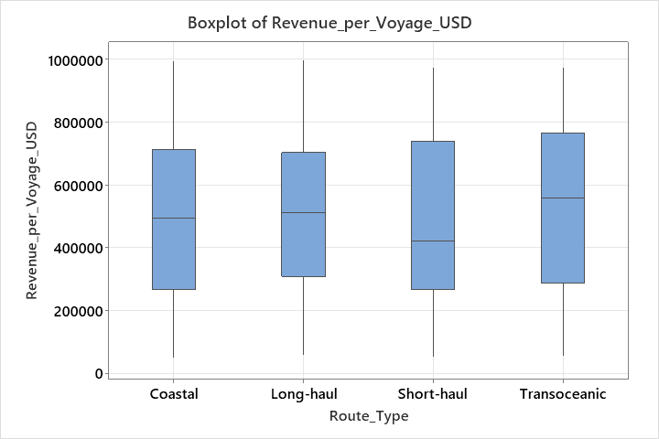
Tanker
The cost distribution is relatively similar across route types, with no significant outliers.
Efficiency appears to be consistent across routes, with minor variations in medians.
Revenue distribution remains comparable, but transoceanic routes show slightly higher median revenue.
Key Insights:
Route type alone does not show a strong impact on operational cost, efficiency, or revenue. Further analysis is needed to identify additional influencing factors.

Slide 30
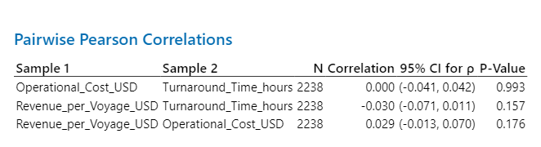
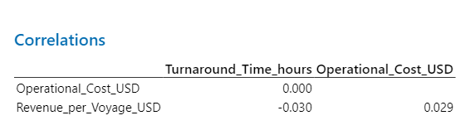
Hypothesis Test for Relationship between Turnaround Time, Operational Cost, and Revenue
Hypothesis Statement:
H₀ (Null Hypothesis): Turnaround Time is not correlated with Operational Cost and Revenue.
H₁ (Alternative Hypothesis): Turnaround Time is correlated with Operational Cost and Revenue.
Test Used: Pearson Correlation Coefficient Decision Rule: If p-value < 0.05, reject H₀ and accept H₁ (significant correlation). If p-value > 0.05, fail to reject H₀ (no significant correlation).
Conclusion
Since all p-values are greater than 0.05, we fail to reject H₀.
Turnaround Time does not strongly influence cost or revenue (P > 0.05), indicating other operational factors have a greater impact’
Key Insights: Turnaround time does not significantly affect cost or revenue—other factors must be analyzed

Slide 31
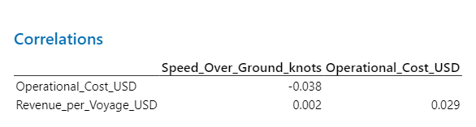
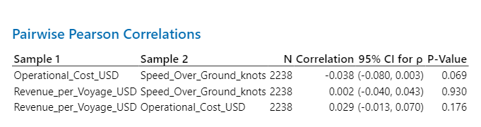
Hypothesis Test: Impact of Speed Over Ground on Cost & Revenue
Hypothesis Statement:
H₀ (Null Hypothesis): Speed Over Ground is not correlated with Operational Cost and Revenue.
H₁ (Alternative Hypothesis): Speed Over Ground is correlated with Operational Cost and Revenue.
Test Used: Pearson Correlation Coefficient Decision Rule: If p-value < 0.05, reject H₀ and accept H₁ (significant correlation). If p-value > 0.05, fail to reject H₀ (no significant correlation).
Conclusion:
All p-values are greater than 0.05, so we fail to reject H₀.
This indicates no significant correlation between Speed Over Ground, Operational Cost, and Revenue.
Key Insights: Speed Over Ground does not significantly impact operational cost or revenue—suggesting that other factors contribute more to cost and revenue changes.

Slide 32
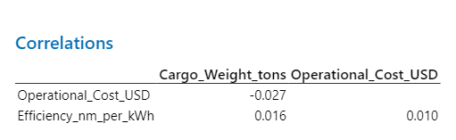
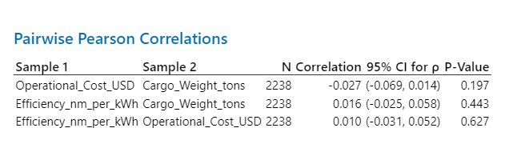
Hypothesis Test: Impact of Cargo Weight on Cost & Efficiency
Hypothesis Statement:
➤ H₀ (Null Hypothesis): Cargo weight is not correlated with operational cost and efficiency. ➤ H₁ (Alternative Hypothesis): Cargo weight is correlated with operational cost and efficiency.
Test Used: Pearson Correlation Coefficient
Decision Rule: If p-value < 0.05, reject H₀ and accept H₁ (significant correlation). If p-value > 0.05, fail to reject H₀ (no significant correlation).
Conclusion:
All p-values are greater than 0.05, so we fail to reject H₀. This indicates no significant correlation between Cargo Weight, Operational Cost, and Efficiency.
Key Insights: Cargo weight does not significantly impact operational cost or efficiency—indicating other factors may influence cost and efficiency changes.

Slide 33
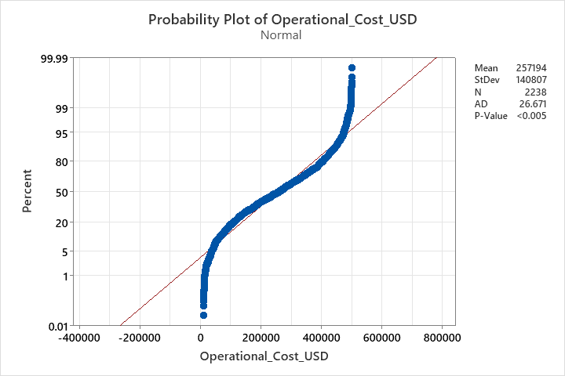
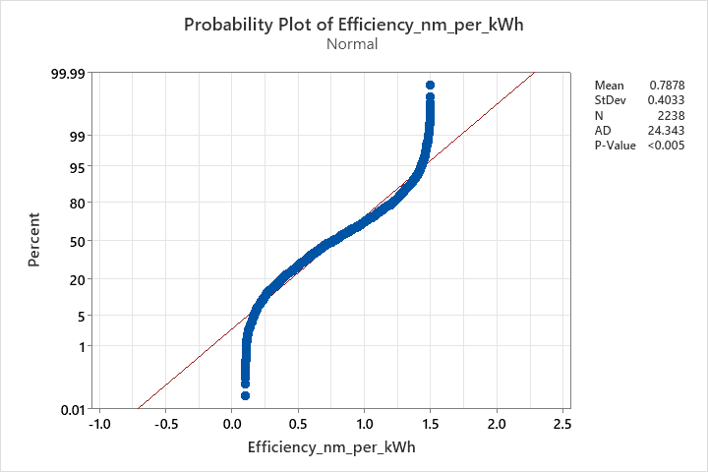
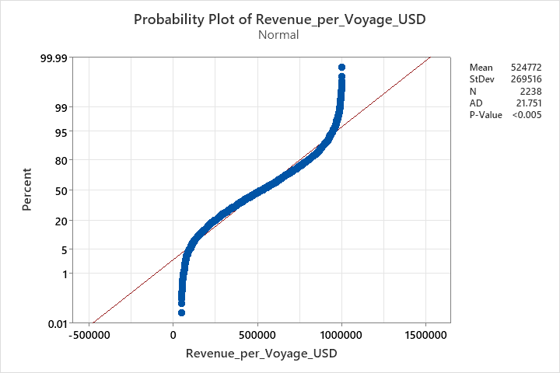
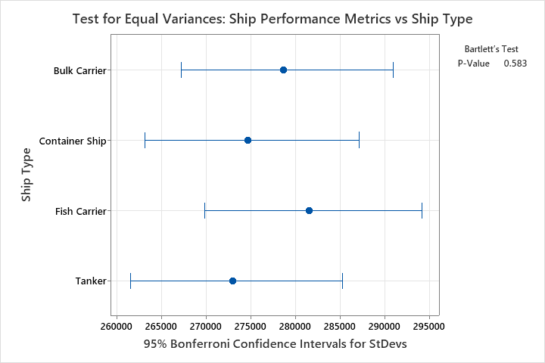
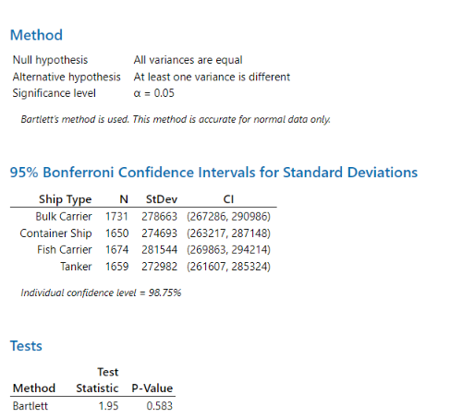

Test for Equal Variances: Ship Performance Metrics Across Ship Types
Fail to Reject H₀ -> Variance are equal

Slide 34



ANOVA: Ship Performance Metrics Across Ship Types
Key Insights:
✅ Null Hypothesis (H₀): All means are equal (No significant difference between Ship Types). ✅ Alternative Hypothesis (H₁): At least one mean is different (There is a significant difference). ✅ P-Value: 0.704 (greater than 0.05) → Fail to Reject H₀ → No significant difference between ship types. ✅ F-Value Interpretation: 0.47 is small, indicating that variation between Ship Types is not significant compared to the error variation.
Conclusion Box: Since P = 0.704 (> 0.05), we fail to reject H₀​. This confirms that ship performance metrics do not significantly vary across ship types.

Slide 35


Tukey Post-Hoc Test: Ship Performance Metrics vs. Ship Type
Tukey Pairwise Comparisons
Inference:
All ship types share the same grouping (A) → No significant difference.
Confidence intervals cross zero → Fail to reject H₀.
Conclusion:
Ship performance metrics do not significantly vary across ship types.

Slide 36



Test for Equal Variances: Ship Performance Metrics versus Route Type
Fail to Reject H₀ -> Variances are equal

Slide 37



ANOVA: Ship Performance Metrics versus Route Type
Key inference:
P-Value = 0.767 (> 0.05) → Fail to Reject H₀ → No significant difference in Ship Performance Metrics across Route Types
Conclusion:
Since the P-Value (0.767) is greater than 0.05, we fail to reject the null hypothesis (H₀).
This means there is no statistically significant difference in Ship Performance Metrics across different Route Types.
The F-Value (0.38) is also small, indicating that the variation between Route Types is not significant compared to the error variation.

Slide 38


Tukey Post-Hoc Test: Ship Performance Metrics vs. Route Type
Tukey Pairwise Comparisons
Inference:
All route types share the same grouping (A) → No significant difference.
Confidence intervals cross zero → Fail to reject H₀.
Conclusion:
Ship performance metrics do not significantly vary across route types.

Slide 39

Regression Analysis - Ship Performance Metrics
Purpose: Identifying significant predictors for ship performance metrics.
Three separate regression analyses conducted:
Operational Cost vs. Predictors
Revenue per Voyage vs. Predictors
Efficiency per kWh vs. Predictors
Notes:
Possible Predictors: Distance traveled, fuel consumption, cargo weight, ship type
Possible Predictors: Cargo load, trip duration, fuel efficiency, route type
Possible Predictors: Ship speed, maintenance schedule, cargo weight, weather conditions

Slide 40


Regression Analysis: Operational Cost vs. Predictors
Key Insights :
The model explains 0.65% of operational cost variance, suggesting key cost drivers (e.g., fuel prices, maintenance schedules) are missing.
Consider alternative predictors such as fuel type, operational conditions, and external cost drivers (e.g., port fees).
Recommendation:
👉 Further analysis may be needed to identify key cost drivers beyond the available predictors.

Slide 41

Cont..
Analysis of Variance
Source | DF | Adj SS | Adj MS | F-Value | P-Value
Regression | 17 | 2.89E+11 | 1.7E+10 | 0.86 | 0.627
Coefficients Key Insights:
The model is not statistically significant (P-value > 0.05), meaning predictor variables do not explain operational cost variation.
Low R² (0.65%) → Model has very weak explanatory power.
Regression: P-Value = 0.627 → Model is NOT significant.
Key Insights:
P-value > 0.05 → Model is statistically insignificant
F-value = 0.86 → Predictors do not significantly impact operational cost
Residual Plots Interpretation:
Residuals are not normally distributed, violating regression assumptions.
Patterns in residuals suggest poor model fit.
High variance in residuals suggests missing key predictors.
Notes:
We performed regression analysis to check whether our selected predictors significantly impact Operational Cost. However, the results show that the model is not statistically significant

Slide 42

Cont…
Summary of Regression Analysis:
The model explains only 0.65% of the variance in operational cost, indicating weak explanatory power.
Next Steps: Explore additional cost drivers such as fuel prices, port fees, operational efficiencies, and economic factors.

Slide 43


Regression Analysis: Revenue per Voyage vs. Predictors
Key Insights:
R² = 0.83% → suggests revenue is driven by external factors like market pricing and cargo type.
Adjusted R² = 0.07% → Adding predictors does not improve the model.
Predicted R² = 0.00% → Current predictors do not significantly explain efficiency variation (R² = 0.66%). Alternative variables such as engine condition and route optimization may improve the model
Key Insight:
While Distance Traveled (P = 0.015) is statistically significant, the model only explains 0.83% of revenue variance, indicating stronger factors like market conditions or pricing strategy may be needed

Slide 44

Cont…
ANOVA summary
Regression P-Value = 0.355 → Model is NOT significant overall.
One predictor (Distance Traveled, P = 0.015) is significant,
but the model still explains little variation in revenue.
F-Value = 1.09 → Other predictors have no meaningful
impact on revenue.
Coefficients
Term | Coef | SE Coef | T-Value | P-Value | VIF
Constant | 482049 | 43957 | 10.97 | 0
Distance_Traveled_nm | 24.5 | 10.1 | 2.43 | 0.015 | 1.01
Key Insights of Coefficients:
Distance Traveled_nm (P = 0.015) is the only significant predictor.
Interpretation: For every 1 nautical mile increase, revenue increases by $24.50 on average.
However, R² = 0.83%, meaning other variables are more influential in driving revenue.
VIF (1.01) → No multicollinearity concerns.
Inference for Residual Plots:
Residuals are NOT normally distributed, violating regression assumptions.
Patterns in residuals suggest the model misses key revenue drivers.
High variance → The model fails to capture revenue variability.
Consider transformations or adding more predictors (e.g., market demand, pricing strategy, port fees).

Slide 45

Summary Conclusion
The model explains only 0.83% of the variance in revenue per voyage, suggesting that key revenue drivers are missing.
Next Steps: Consider factors like market demand, dynamic pricing strategies, cargo types, and seasonal variations to enhance predictive capability.

Slide 46


Regression Analysis - Efficiency per kWh vs. Predictors
Inference for Model Summary:
R² = 0.66% → The model accounts for only a negligible portion of efficiency variation, suggesting weak explanatory power.
Adjusted R² = 0.00% → Adding predictors does not enhance model performance, indicating the need for alternative variables.
Predicted R² = 0.00% → Model fails to generalize and is unsuitable for efficiency forecasting.
Inference for Regression Equation:
None of the predictors significantly impact efficiency (P > 0.05), indicating poor model fit and the need for additional relevant variables.
R² = 0.66% → The model explains only 0.66% of efficiency variance, indicating weak explanatory power and poor predictive utility. Alternative variables or transformations may be needed
Conclusion:
The model lacks predictive power and does not effectively estimate efficiency per kWh.

Slide 47

Further Analysis: Efficiency per kWh Model Insights
Inference for Coefficients
No significant predictors: All variables have P-values > 0.05, meaning none have a meaningful impact on Efficiency per kWh.
No multicollinearity concerns (VIF < 5), indicating predictor independence.
Conclusion: The model is weak and does not explain variations in Efficiency per kWh.
Anova Inference:
Regression P-Value = 0.618 → The model is not significant.
F-Value = 0.86 → No meaningful predictor impact on efficiency.
None of the predictors significantly explain Efficiency per kWh (P > 0.05).
Low R² (0.66%) → Model explains almost no variation in efficiency.
Inference for Residuals:
Residuals show non-normality and high variance, indicating key variables are missing from the model. Consider transformations or alternative predictors to improve fit.
Conclusion: Model fit is weak; consider transformations or alternative predictors.

Slide 48

Conclusion
The model explains only 0.66% of the variance in efficiency per kWh, making it unsuitable for prediction.
Next Steps: Investigate operational strategies, ship technology, and energy management techniques

Slide 49
Identifying Waste in Ship Performance Metrics
In Lean methodology, waste is classified into 8 types (TIMWOODS):
1. T - Transportation: Unnecessary ship movements increasing fuel consumption
2. I - Inventory: Excess spare parts and fuel stockpiling increasing costs
3. M - Motion: Inefficient routing of ships causing excess fuel use
4. W - Waiting: Delays in ship loading/unloading affecting efficiency
5. O - Overproduction: Unnecessary data collection beyond requirements
6. O - Overprocessing: Redundant reports and excessive data validation
7. D - Defects: Errors in ship performance data leading to incorrect analysis
8. S - Skills (Non-utilized Talent): Crew members' expertise not used for optimization
Conclusion: Reducing these wastes will improve operational efficiency by eliminating non-value-added activities, lowering costs, and improving turnaround time.

Slide 50
FMEA
Failure Mode | Potential Effects | S (Severity) | O (Occurrence) | D (Detection) | RPN (S×O×D) | Recommended Action
Poor fuel efficiency | Increased operational cost | 8 | 6 | 4 | 192 | Optimize engine power, monitor fuel usage via IoT
Route inefficiency | Delays, increased fuel use | 7 | 5 | 6 | 210 | Implement AI-based route optimization
Incorrect cargo loading | Structural damage, instability | 9 | 3 | 5 | 135 | Enforce weight distribution checks
Inaccurate weather data | Unplanned route changes, safety risk | 9 | 4 | 5 | 180 | Integrate real-time satellite weather data
Unplanned maintenance | Ship downtime, delays | 7 | 5 | 6 | 210 | Implement predictive maintenance analytics
Conclusion: Focus on high RPN risks (Route Inefficiency and Unplanned Maintenance) to improve ship performance.

Slide 51

Improve Phase

Slide 52
Brainstorming Solutions - Key Focus Areas
1. Training & Workforce Optimization
- Skill enhancement programs for crew members
- Shift and workload balancing to minimize downtime
2. Predictive Maintenance & Automation
- Implementing AI-driven predictive maintenance
- Automating monitoring systems for early anomaly detection
3. Route & Scheduling Optimization
- Using machine learning models for real-time route adjustments
- Data-driven scheduling strategies for reducing inefficiencies
4. Process & Waste Reduction
- Identifying bottlenecks in ship performance metrics
- Lean Six Sigma approaches to reduce fuel and maintenance costs

Slide 53

Key Improvement Strategies
1. Lean Techniques
Standardized training programs to address skill gaps.
Workforce optimization through better shift planning.
Improved maintenance planning to prevent unplanned breakdowns.
2. Scheduling Optimization
Implement data-driven scheduling to align workload and minimize delays.
Use AI-based predictive scheduling for voyage planning.
3. Route Optimization
Develop a route optimization model using historical performance data.
Optimize fuel efficiency by selecting cost-effective routes.
4. Predictive Maintenance Implementation
Leverage machine learning models to predict engine failures.
Implement condition-based maintenance strategies.

Slide 54
Cont….
5. Automation in Performance Monitoring
Use real-time ship tracking and analytics.
Implement automated alerts for maintenance scheduling.
6. Reducing Waste (DOWNTIME Approach)
Defects: Improve data accuracy through automation.
Waiting: Reduce ship loading/unloading delays with automated scheduling.
Excess Processing: Reduce reporting redundancies.

Slide 55
Describe Solution(s) Selected
No | Root Cause(s) | Actions Planned | Planned Completion Date | Responsibility | Actual Completion Date | Status
1 | Lack of Skilled Labor | Implement workforce training & certification programs | 1-Mar-24 | HR & Training | 1-Apr-24 | Open
2 | Inefficient Scheduling | Deploy AI-based predictive scheduling | 15-Mar-24 | Operations | 20-Mar-24 | Open
3 | Route Inefficiencies | Develop & implement real-time route optimization model | 10-Apr-24 | Logistics & IT | 15-Apr-24 | Open
4 | Unplanned Maintenance | Integrate predictive maintenance strategies | 5-Apr-24 | Engineering | 10-Apr-24 | Open
5 | Lack of Real-Time Tracking | Implement ship tracking & automated alerts | 20-Apr-24 | IT & Operations | 25-Apr-24 | Open

Slide 56
Pilot Study for Improvement Implementation
Duration: 3 months
Key Metrics to Track:
Reduction in turnaround time (target < 60 hours).
Increase in efficiency (nm/kWh).
Reduction in maintenance downtime.
Cost savings through optimized scheduling.
Expected Outcomes
20-30% reduction in turnaround time.
10-15% reduction in operational costs.
Improved predictive maintenance compliance.
Enhanced workforce productivity & reduced scheduling inefficiencies.

Slide 57

Control Phase

Slide 58
Data Collection Plan for Continuous Monitoring
CTQ (Critical to Quality Factor) | Measure Description (Operational Definition) | Data Type (Continuous/Discrete) | Sampling Frequency | How Collected? | By Whom?
Turnaround Time (TAT) | Time taken for process completion from start to finish | Continuous | Weekly | System logs & manual tracking | Operations Team
Delay Causes | Categorization of delay reasons | Discrete | Weekly | Root Cause Analysis | Process Analysts
Out-of-Control Events | Number of points beyond control limits | Discrete | Weekly | Control Chart Review | Quality Control Team
Process Stability | Standard deviation & range analysis | Continuous | Monthly | Statistical Process Control (SPC) | Six Sigma Team

Slide 59

Monitoring
Notes:
The I-MR chart shows improved process stability post-implementation. The average turnaround time is now 38.05 hours, with reduced variation in performance. A few out-of-control points exist, requiring ongoing monitoring, but overall, the process has stabilized significantly

Slide 60

Before improvement, variation was high. After improvement, process stability increased with lower deviations.
Notes:
The before improvement chart shows high variation in turnaround time, leading to operational inefficiencies. After implementing process improvements, variation decreased, and control limits tightened, ensuring a more stable and predictable process. This confirms the effectiveness of the improvements made.

Slide 61

Statistical Validation: Paired T-Test Results
Inference:
Before: “Turnaround time before improvement: 41.744, after improvement: 38.055.”
After: “TAT significantly reduced after improvement (p < 0.05, strong statistical evidence)”
Null Hypothesis Rejected → Improvement is statistically significant and not due to random variation

Slide 62

After improvement – Normality test
Key Learnings: Data follows a normal distribution (p > 0.05), validating parametric statistical tests.

Slide 63

Improved Process Capability: Post-Implementation Analysis
Process capability improved, but Cpk = 1.00 suggests further optimization is needed to reach Six Sigma standards (Cpk > 1.03)

Slide 64
Next Steps & Recommendations
Implement continuous process monitoring using control charts.
Regularly reassess process capability to ensure sustained improvements.
Investigate outliers and sources of variation for further process stabilization.
Explore additional Six Sigma methodologies to optimize other process areas.
Standardize best practices for long-term process efficiency.

